Slide 1

CHAPTER 16
Security
Notes:
1.#

Slide 2
Objectives
After studying this chapter, the student should be able to:
Define security goals—confidentiality, integrity, and availability.
Show how confidentiality can be achieved using symmetric-key
and asymmetric-key cipher.
Discuss other aspects of security: message integrity, message
authentication, digital signature, entity authentication, and key
management.
Discuss the use of Firewalls to protect a system from harmful message.

Slide 3
16-1 INTRODUCTION
We are living in the information age. We need to keep information about every aspect of our lives. In other words, information is an asset that has a value like any other asset. As an asset, information needs to be secured from attacks. To be secured, information needs to be hidden from unauthorized access (confidentiality), protected from unauthorized change (integrity), and available to an authorized entity when it is needed (availability).
During the last three decades, computer networks have created a revolution in the use of information. Information is now distributed. Authorized people can send and retrieve information from a distance using computer networks. Although the three above-mentioned requirements changed, they now have some new dimensions. Not only should information be confidential when it is stored; there should also be a way to maintain its confidentiality when it is transmitted from one computer to another.

Slide 4
16.1 Security goals
We will first discuss three security goals: confidentiality, integrity, and availability.
Confidentiality
Confidentiality, keeping information secret from unauthorized access, is probably the most common aspect of information security: we need to protect confidential information. An organization needs to guard against those malicious actions that endanger the confidentiality of its information.
Integrity
Information needs to be changed constantly. In a bank, when a customer deposits or withdraws money, the balance of their account needs to be changed. Integrity means that changes should be done only by authorized users and through authorized mechanisms.

Slide 5
Availability
The third component of information security is availability. The information created and stored by an organization needs to be available to authorized users and applications. Information is useless if it is not available. Information needs to be changed constantly, which means that it must be accessible to those authorized to access it. Unavailability of information is just as harmful to an organization as a lack of confidentiality or integrity. Imagine what would happen to a bank if the customers could not access their accounts for transactions.

Slide 6
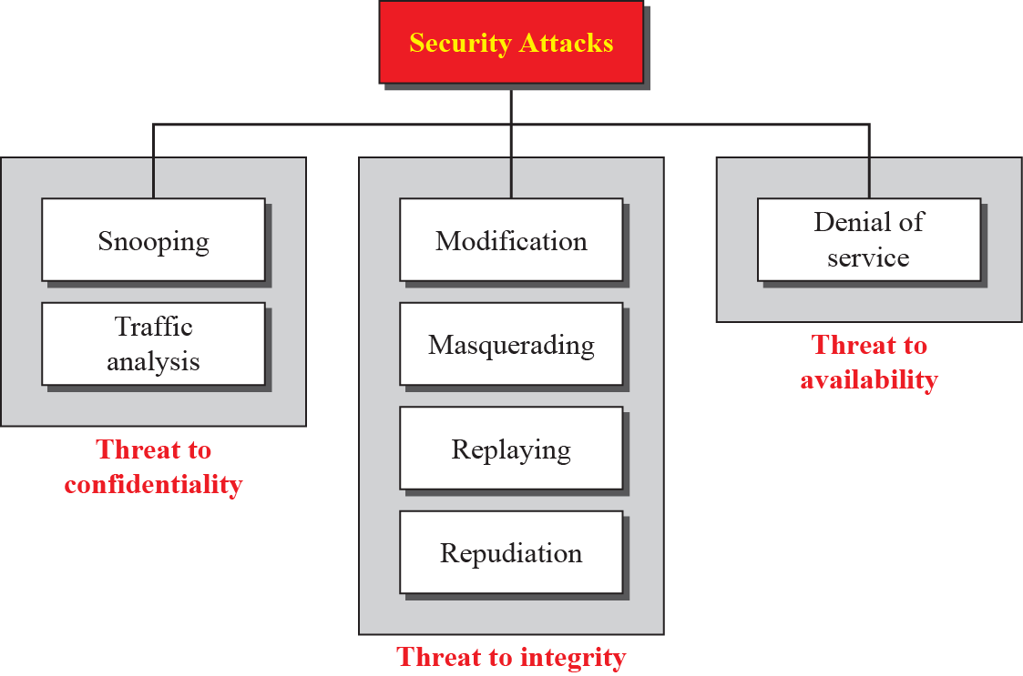
16.1.2 Attacks
The three goals of security—confidentiality, integrity, and availability—can be threatened by security attacks. Figure 16.2 relates the taxonomy of attack types to security goals.
Figure 16.1 Taxonomy of attacks with relation to security goals

Slide 7
Attacks threatening confidentiality
In general, two types of attack threaten the confidentiality of information: snooping and traffic analysis. Snooping refers to unauthorized access to or interception of data. Traffic analysis refers other types of information collected by an intruder by monitoring online traffic.
Attacks threatening integrity
The integrity of data can be threatened by several kinds of attack: modification, masquerading, replaying, and repudiation.

Slide 8
Attacks threatening availability
We mention only one attack threatening availability: denial of service.

Slide 9
16.1.3 Services and Techniques
ITU-T defines some security services to achieve security goals and prevent attacks. Each of these services is designed to prevent one or more attacks while maintaining security goals. The actual implementation of security goals needs some techniques. Two techniques are prevalent today: one is very general (cryptography) and one is specific (steganography).

Slide 10
Cryptography
Some security services can be implemented using cryptography. Cryptography, a word with Greek origins, means “secret writing”. However, we use the term to refer to the science and art of transforming messages to make them secure and immune to attacks. Although in the past cryptography referred only to the encryption and decryption of messages using secret keys, today it is defined as involving three distinct mechanisms: symmetric-key encipherment, asymmetric-key encipherment, and hashing. We will discuss all these mechanisms later in the chapter.
.
Encryption: C = E_{k}(P) Decryption: P = D_{k}(C)

Slide 11
Steganography
Although this chapter and the next are based on cryptography as a technique for implementing security mechanisms, another technique that was used for secret communication in the past is being revived at the present time: steganography. The word steganography, with origins in Greek, means ‘covered writing’, in contrast with cryptography, which means ‘secret writing’. Cryptography means concealing the contents of a message by enciphering; steganography means concealing the message itself by covering it with something else. We leave the discussion of steganography to those books dedicated to this topic.
.

Slide 12
16-2 Confidentiality
We now look at the first goal of security, confidentiality. Confidentiality can be achieved using ciphers. Ciphers can be divided into two broad categories: symmetric-key and asymmetric-key.

Slide 13
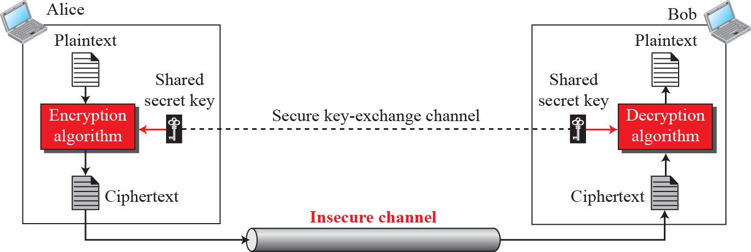
16.2.1 Symmetric-key Ciphers
A symmetric-key cipher uses the same key for both encryption and decryption, and the key can be used for bidirectional communication, which is why it is called symmetric. Figure 16.2 shows the general idea behind a symmetric-key cipher.
Figure 16.2 General idea of symmetric-key cipher

Slide 14

Symmetric-key ciphers are also called secret-key ciphers.
Note that the symmetric-key encipherment uses a single key (the key itself may be a set of values) for both encryption and decryption. In addition, the encryption and decryption algorithms are inverses of each other. If P is the plaintext, C is the ciphertext, and K is the key, the encryption algorithm Ek(x) creates the ciphertext from the plaintext; the decryption algorithm Dk(x) creates the plaintext from the ciphertext. We assume that Ek(x) and Dk(x) are inverses of each other: they cancel the effect of each other if they are applied one after the other on the same input. We have:

Slide 15
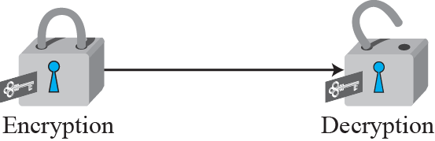
Encryption can be thought of as locking the message in a box; decryption can be thought of as unlocking the box. In symmetric-key encipherment, the same key locks and unlocks, as shown in Figure 16.3. Later sections show that the asymmetric-key encipherment needs two keys, one for locking and one for unlocking.
Figure 16.3 Locking and unlocking with the same key

Slide 16

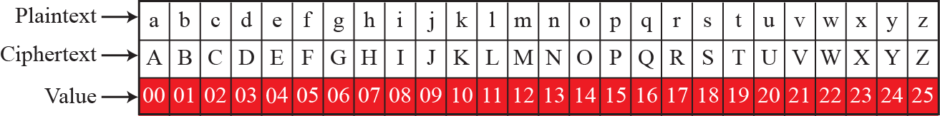

Traditional symmetric-key ciphers
Traditional ciphers belong to the past. However, we briefly discuss them here because they can be thought of as the components of the modern ciphers. To be more exact, we can divide traditional ciphers into substitution ciphers and transposition ciphers.
A substiturion cipher replaces one symbol with another
Figure 16.4 Representation of plaintext and ciphertext in modulo 26
In additive cipher, the plaintext, ciphertext, and key are integer in modulo 26

Slide 17
Example 16.1
Use the additive cipher with key = 15 to encrypt the message “hello”.
Solution
We apply the encryption algorithm to the plaintext, character by character:
Plaintext: h → 07 Encryption: (07 + 15) mod 26 Ciphertext: 22 → W
Plaintext: e → 04 Encryption: (04 + 15) mod 26 Ciphertext: 19 → T
Plaintext: l → 11 Encryption: (11 + 15) mod 26 Ciphertext: 00 → A
Plaintext: l → 11 Encryption: (11 + 15) mod 26 Ciphertext: 00 → A
Plaintext: o → 14 Encryption: (14 + 15) mod 26 Ciphertext: 03 → D
The ciphertext is therefore “wtaad”.

Slide 18
Example 16.2
Use the additive cipher with key 5 = 15 to decrypt the message ‘WTAAD’.
Solution
We apply the decryption algorithm to the plaintext character by character:
Ciphertext: W → 22 Decryption: (22 → 15) mod 26 Plaintext: 07 → h
Ciphertext: T → 19 Decryption: (19 → 15) mod 26 Plaintext: 04 → e
Ciphertext: A → 00 Decryption: (00 → 15) mod 26 Plaintext: 11 → l
Ciphertext: A → 00 Decryption: (00 → 15) mod 26 Plaintext: 11 → l
Ciphertext: D → 03 Decryption: (03 → 15) mod 26 Plaintext: 14 → o
The result is ‘hello’. Note that the operation is in modulo 26, which means that we need to add 26 to a negative result (for example -15 becomes 11).

Slide 19
In a polyalphabetic cipher, each occurrence of a character may have a different substitute. The relationship between a character in the plaintext to a character in the ciphertext is one-to-many. For example, ‘a’ could be enciphered as ‘D’ at the beginning of the text, but as ‘N’ in the middle. Polyalphabetic ciphers have the advantage of hiding the letter frequency of the underlying language. Eve cannot use single-letter frequency statistics to break the ciphertext.
To see the position dependency of the key, let us discuss a simple polyalphabetic cipher called the autokey cipher. In this cipher, the key is a stream of subkeys, in which each subkey is used to encrypt the corresponding character in the plaintext. The first subkey is a predetermined value secretly agreed upon by Alice and Bob. The second subkey is the value of the first plaintext character (between 0 and 25). The third subkey is the value of the second plaintext character, and so on.

Slide 20
Example 16.3
Assume that Alice and Bob agreed to use an autokey cipher with initial key value k1 = 12. Now Alice wants to send Bob the message ‘Attack is today’. Enciphering is done character by character. Each character in the plaintext is first replaced by its integer value. The first subkey is added to create the first ciphertext character. The rest of the key is created as the plaintext characters are read. Note that the cipher is polyalphabetic because the three occurrences of ‘a’ in the plaintext are encrypted differently. The three occurrences of ‘t’ are encrypted differently.
Plaintext: a t t a c k i s t o d a y
P’s Values: 00 19 19 00 02 10 08 18 19 14 03 00 24
Key stream: 12 00 19 19 00 02 10 08 18 19 14 03 00
C’s Values: 12 19 12 19 02 12 18 00 11 7 17 03 24
Ciphertext: M T M T C M S A L H R D Y

Slide 21

A transposition cipher does not substitute one symbol for another; instead it changes the location of the symbols. A symbol in the first position of the plaintext may appear in the tenth position of the ciphertext. A symbol in the eighth position in the plaintext may appear in the first position of the ciphertext. In other words, a transposition cipher reorders (transposes) the symbols.
A transposition cipher reorders symbols.

Slide 22
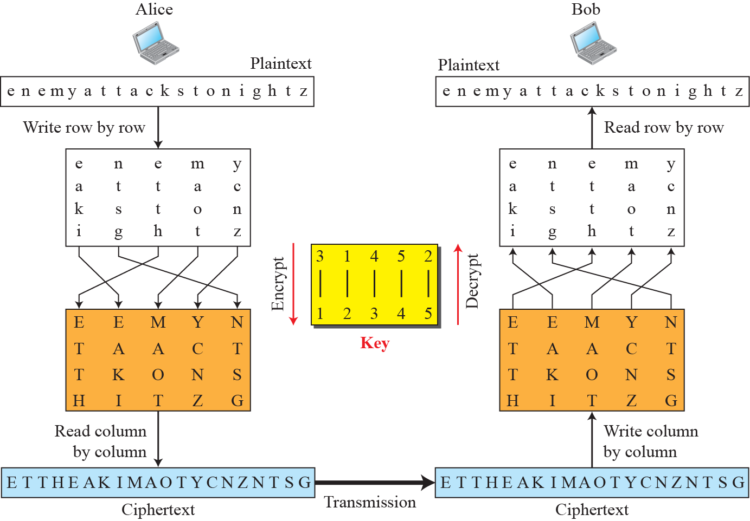
Figure 16.5 Transposition cipher

Slide 23
Stream and block ciphers
The literature divides the symmetric ciphers into two broad categories: stream ciphers and block ciphers.
In a stream cipher, encryption and decryption are done one symbol (such as a character or a bit) at a time. We have a plaintext stream, a ciphertext stream, and a key stream. Call the plaintext stream P, the ciphertext stream C, and the key stream K.
P = P₁P₂P₃, … C = C₁C₂C_{3,} … K = (k₁, k₂, k₃, …)
C1 = E_{k1}(P1) C2 = E_{k2}(P2) C3 = E_{k3}(P3) …

Slide 24
Modern symmetric-key ciphers
The literature divides the symmetric ciphers into two broad categories: stream ciphers and block ciphers.
In a stream cipher, encryption and decryption are done one symbol (such as a character or a bit) at a time. We have a plaintext stream, a ciphertext stream, and a key stream. Call the plaintext stream P, the ciphertext stream C, and the key stream K.
P = P₁P₂P₃, … C = C₁C₂C_{3,} … K = (k₁, k₂, k₃, …)
C1 = E_{k1}(P1) C2 = E_{k2}(P2) C3 = E_{k3}(P3) …

Slide 25
Modern symmetric-key ciphers
The traditional symmetric-key ciphers that we have studied so far are character-oriented ciphers. With the advent of the computer, we need bit-oriented ciphers. This is because the
information to be encrypted is not just text; it can also consist of numbers, graphics, audio, and video data. It is convenient to convert these types of data into a stream of bits, to encrypt the stream, and then to send the encrypted stream. In addition, when text is treated at the bit level, each character is replaced by 8 (or 16) bits, which means that the
number of symbols becomes 8 (or 16) times larger. Mixing a larger number of symbols increases security. A modern cipher can be either a block cipher or a stream cipher.

Slide 26
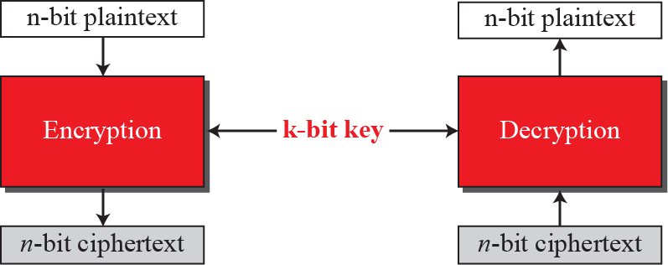
A symmetric-key modern block cipher encrypts an n-bit block of plaintext or decrypts an n-bit block of ciphertext. The encryption or decryption algorithm uses a k-bit key. The
decryption algorithm must be the inverse of the encryption algorithm, and both operations must use the same secret key so that Bob can retrieve the message sent by Alice. Figure 16.6 shows the idea behind a modern block cipher.
Figure 16.6 A modern block cipher

Slide 27
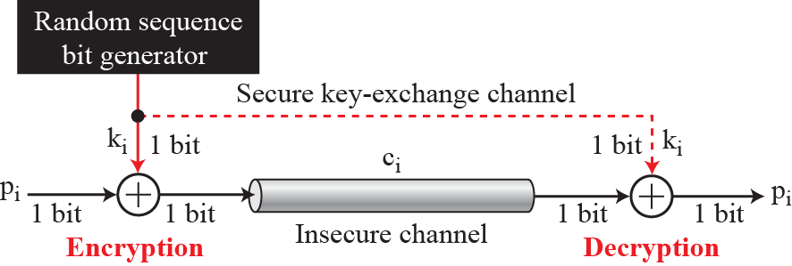
In addition to modern block ciphers, we can also use modern stream ciphers. The differences between modern stream ciphers and modern block ciphers are similar to the differences between traditional stream and block ciphers. The simplest and the most secure type of synchronous stream cipher is called the one-time pad, which was invented and patented by Gilbert Vernam (Figure 16.7)
Figure 16.7 One-time pad

Slide 28

16.2.2 Asymmetric-key ciphers
Symmetric- and asymmetric-key ciphers will exist in parallel and continue to serve the community. The conceptual differences between the two systems are based on how these systems keep a secret. In symmetric-key cryptography, the secret must be shared between two persons. In asymmetric-key cryptography, the secret is personal (unshared); each person creates and keeps his or her own secret.
In a community of n people, n (n - 1)/2 shared secrets are needed for symmetric-key cryptography; n personal secrets are needed in asymmetric-key cryptography. personal secrets.
Symmetric-key cryptography is based on sharing secrecy;
asymmetric-key cryptography is based on personal secrecy.

Slide 29

Whereas symmetric-key cryptography is based on substitution and permutation of symbols (characters or bits), asymmetric-key cryptography is based on applying mathematical functions to numbers. In symmetric-key cryptography, the plaintext and ciphertext are thought of as a combination of symbols. Encryption and decryption permute
these symbols or substitute one symbol for another. In asymmetric-key cryptography, the plaintext and ciphertext are numbers; encryption and decryption are mathematical functions that are applied to numbers to create other numbers.
In symmetric-key cryptography, symbols are manipulated:
in asymmetric-key cryptography, numbers are manipulated.

Slide 30
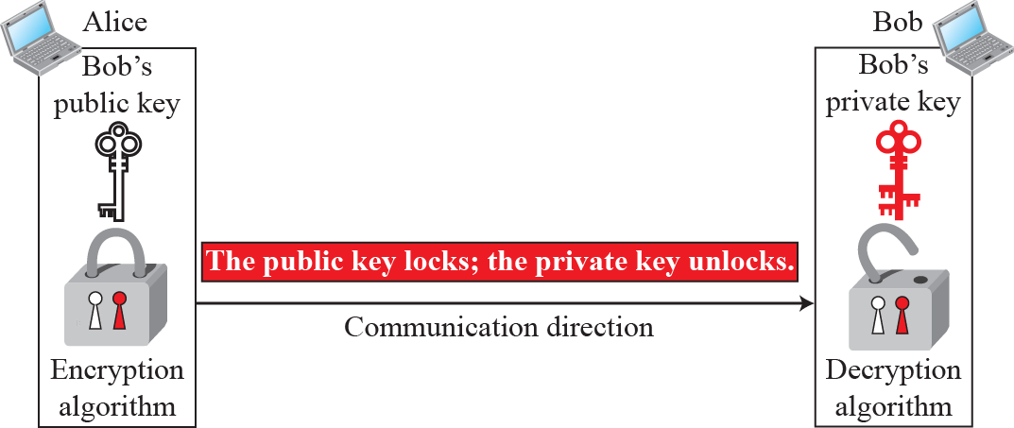

Figure 16.8 Locking and unlocking in asymmetric-key cryptography
Asymmetric-key ciphers are sometimes called public-key ciphers.

Slide 31
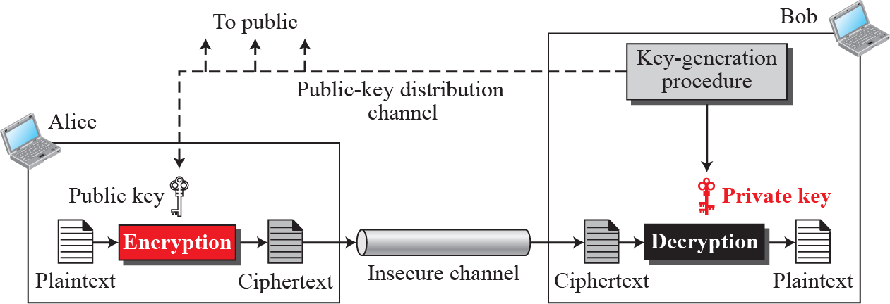

General Idea
Figure 16.9 shows the general idea of asymmetric-key cryptography as used for encipherment.
Figure 16.9 General idea of asymmetric-key cryptography
Asymmetric-key cryptography is normally used to encrypt
or decrypt small pieces of information..

Slide 32
RSA cryptosystem
Although there are several asymmetric-key cryptosystems, one of the common public-key algorithms is the RSA cryptosystem, named for its inventors (Rivest, Shamir, and Adleman). RSA uses two exponents, e and d, where e is public and d is private. Suppose P is the plaintext and C is the ciphertext. Alice uses C 5 Pe mod n to create ciphertext C
from plaintext P; Bob uses P 5 Cd mod n to retrieve the plaintext sent by Alice. The modulus n, a very large number, is created during the key generation process.

Slide 33
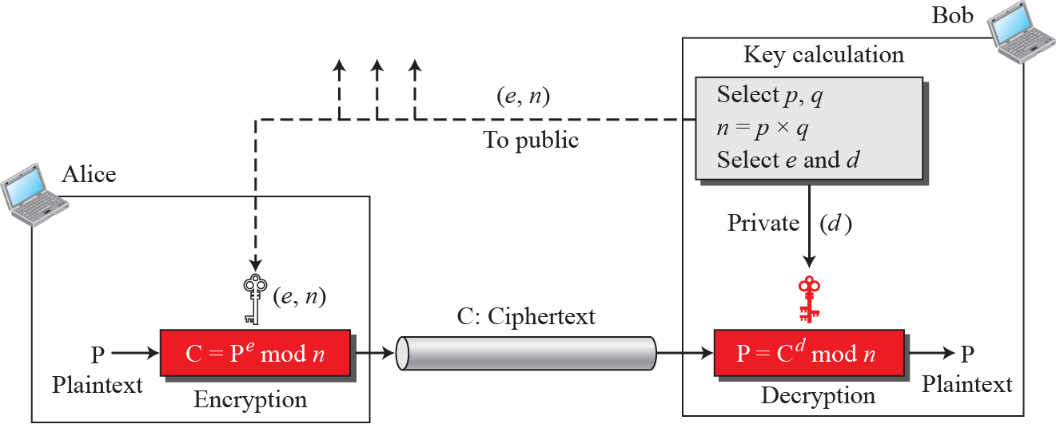
Figure 16.10 Encryption, decryption, and key generation in RSA

Slide 34
Example 16.4
For the sake of demonstration, let Bob choose 7 and 11 as p and q and calculate f 5 7 3 11 5 77. The value of f(n) 5 (7 - 1)(11 - 1), or 60. If he chooses e to be 13, then d is 37. Note that e × d mod 60 = 1. Now imagine that Alice wants to send the plaintext 5 to Bob. She uses the public exponent 13 to encrypt 5. This system is not safe because p and q are small.
Plaintext: 5 Ciphertext: 26
C = 5¹³ = 26 mod 77 P = 26³⁷ = 5 mod 77
Ciphertext: 26 Plaintext: 5

Slide 35
Example 16.5
Here is a more realistic example calculated using a computer program in Java. We choosea 512-bit p and q, and calculate n and f(n). We then choose e and calculate d. Finally, we show the results of encryption and decryption. The integer p is a 159-digit number.
p = 9613034531358350457419158128061542790930984559499 6215822583
15087964794045505647063849125716018034750312098666606492420
191808780667421096063354219926661209
q = 12060191957231446918276794204450896001555925054637033936061
79832173148214848376465921538945320917522527322683010712069
5604602513887145524969000359660045617

Slide 36
n = 115935041739676149688925098646158875237714573754541447754855
261376147885408326350817276878815968325168468849300625485764
11125016241455233918292716250765677272746009708271412773043
49605005563472745666280600999240371029914244722922157727985
317270338393813346926841373276220009666766718318310883734208
23444370953
Φ(n)= 11593504173967614968892509864615887523771457375454144775485526137
61478854083263508172768788159683251684688493006254857641112501624
14552339182927162507656751054233608492916752034482627988117554787
65701392344440571698958172819609822636107546721186461217135910735
8640614008885170265377277264467341066243857664128
e = 35535
d = 580083028600377639360936612896779175946690620896509621804228661113
805938528223587317062869100300217108590443384021707298690876006115
306202524959884448047568240966247081485817130463240644077704833134
010850947385295645071936774061197326557424237217617674620776371642
0760033708533328853214470885955136670294831

Slide 37
P = 1907081826081826002619041819
C = 47530912364622682720636555061054518094237179607049171652323924305
44529606131993285666178434183591141511974112520056829797945717360
36101278218847892741566090480023507190715277185914975188465888632
10114835410336165789846796838676373376577746562507928052114814184
404814184430812773059004692874248559166462108656
P = 1907081826081826002619041819
Applications
Although RSA can be used to encrypt and decrypt actual messages, it is very slow if the message is long. RSA, therefore, is useful for short messages. In particular, we will see that RSA is used in digital signatures and other cryptosystems that often need to encrypt a small message without having access to a symmetric key. RSA is also used for authentication, as we will see later in the chapter.

Slide 38
16-3 OTHER ASPECTS OF SECURITY
The cryptography systems that we have studied so far provide confidentiality. However, in modern communication, we need to take care of other aspects of security, such as integrity, message and entity authentication, non-repudiation, and key management. We briefly discuss these issues in this section.
16.3.1 Message integrity
There are occasions where we may not even need secrecy but instead must have integrity: the message should remain unchanged. For example, Alice may write a will to distribute her estate upon her death. The will does not need to be encrypted. After her death, anyone can examine the will. The integrity of the will, however, needs to be preserved. Alice does not want the contents of the will to be changed.

Slide 39
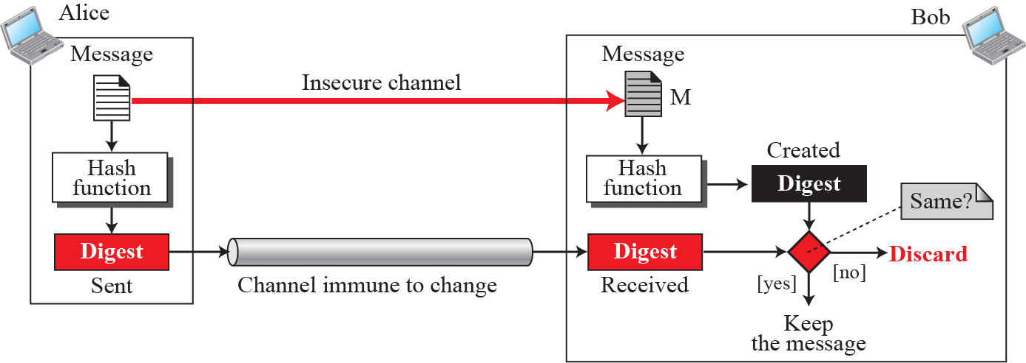
Message and message digest
One way to preserve the integrity of a document is through the use of a fingerprint. The electronic equivalent of the document and fingerprint pair is the message and digest pair. To preserve the integrity of a message, the message is passed through an algorithm called a cryptographic hash function. The function creates a compressed image
Figure 16.11 Message and digest

Slide 40
The message digest needs to be safe from change.
Hash Functions
A cryptographic hash function takes a message of arbitrary length and creates a message digest of fixed length. All cryptographic hash functions need to create a fixed-size digest out of a variable-size message. Creating such a function is best accomplished using iteration. Instead of using a hash function with variable-size input, a function with fixed-size input is created and is used a necessary number of times. The fixed-size input function is referred to as a compression function. It compresses an n-bit string to create an m-bit string where n is normally greater than m. The scheme is referred to as an iterated cryptographic hash function.

Slide 41
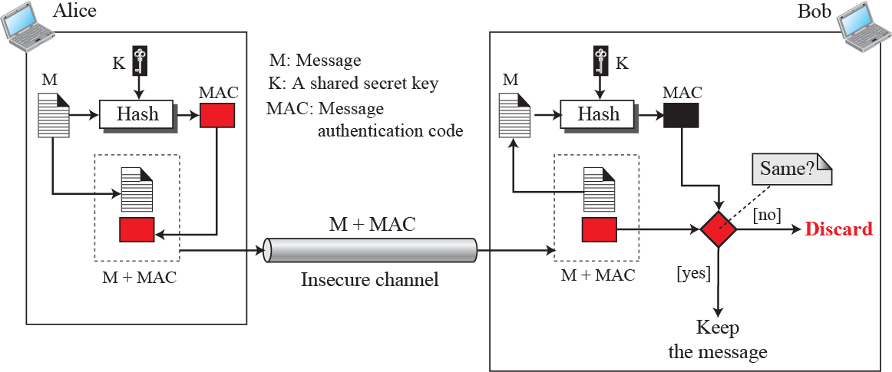
16.3.2 Message authentication
A digest can be used to check the integrity of a message. To ensure the integrity of the message and the data origin authentication—that Alice is the originator of the message, not somebody else—we need to include a secret shared by Alice and Bob (that Eve does not possess) in the process; we need to create a message authentication code (MAC). Figure 16.12 shows the idea.
Figure 16.12 Signing the digest

Slide 42

Alice uses a hash function to create a MAC from the concatenation of the key and the message, h (K + M). She sends the message and the MAC to Bob over the insecure channel. Bob separates the message from the MAC. He then makes a new MAC from the concatenation of the message and the secret key. Bob then compares the newly created MAC with the one received. If the two MACs match, the message is authentic and has not been modified by an adversary.
A MAC provides message integrity and message authentication using a combination of a hash function and a secret key.

Slide 43
HMAC
The National Institute of Standards and Technology (NIST) has issued a standard for a nested MAC that is often referred to as HMAC (hashed MAC). The implementation of HMAC is much more complex than the simplified MAC and is not covered in this text.

Slide 44
16.3.3 Digital signature
Another way to provide message integrity and message authentication (and some more security services, as we will see shortly) is a digital signature. A MAC uses a secret key to
protect the digest; a digital signature uses a pair of private–public keys.
A digital signature uses a pair of private–public keys.

Slide 45
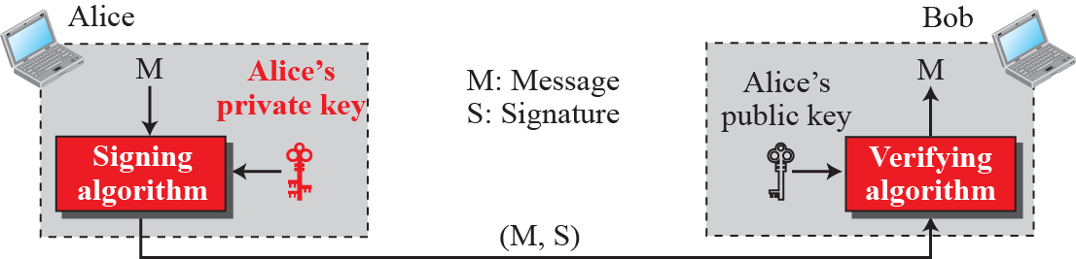
Process
Figure 16.13 shows the digital signature process. The sender uses a signing algorithm to sign the message. The message and the signature are sent to the receiver. The receiver receives the message and the signature and applies the verifying algorithm to the combination. If the result is true, the message is accepted; otherwise, it is rejected.
Figure 16.13 Digital signature process

Slide 46


A digital signature needs a public-key system. The signer signs with
her private key; the verifier verifies with the signer’s public key.
A cryptosystem uses the private and public keys of the receiver;
a digital signature uses the private and public keys of the sender.

Slide 47
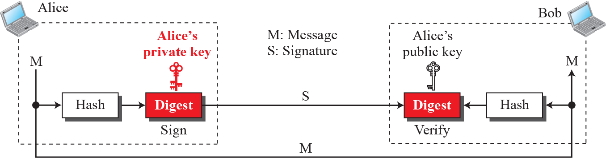
Signing the digest
In a digital signature system, the messages are normally long, but we have to use asymmetric-key schemes. The solution is to sign a digest of the message, which is much shorter than the message. A carefully selected message digest has a one-to-one relationship with the message. The sender can sign the message digest and the receiver can verify the message digest. The effect is the same. Figure 16.14 shows signing a digest in a digital signature system.
Figure 16.14 Signing the digest

Slide 48
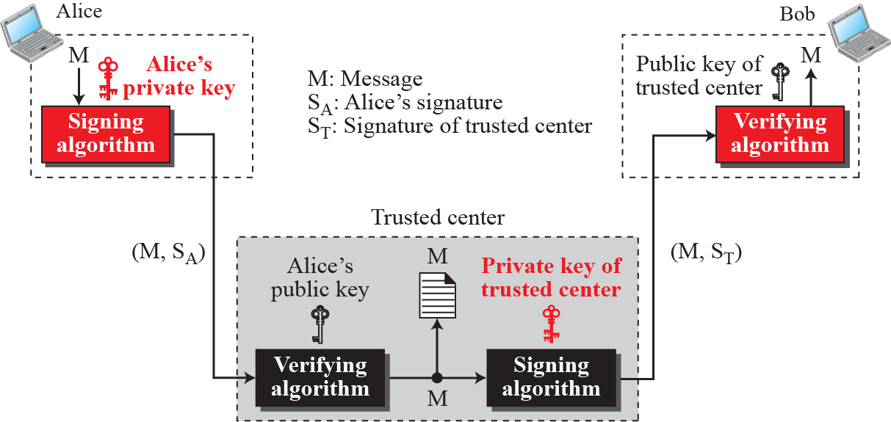
Services
We discussed several security services including message confidentiality, message authentication, message integrity, and non-repudiation. A digital signature can directly provide the last three; for message confidentiality we still need encryption/decryption.
Figure 16.15 Using a trusted center for nonrepudiation

Slide 49
16.3.4 Entity authentication
Entity authentication is a technique designed to let one party verify the identity of another party. An entity can be a person, a process, a client, or a server. The entity whose identity needs to be proven is called the claimant; the party that tries to verify the identity of the claimant is called the verifier.

Slide 50
Verification categories
In entity authentication, the claimant must identify him- or herself to the verifier. This can be done with one of three kinds of witnesses: something known, something possessed, or something inherent.
Something known
Something possessed
Something inherent

Slide 51
Entity versus message authentication
There are two differences between entity authentication and message authentication (data-origin authentication).
Message authentication (or data-origin authentication) might not happen in real time; entity authentication does.
Message authentication simply authenticates one message; the process needs to be repeated for each new message. Entity authentication authenticates the claimant for the entire duration of a session.

Slide 52

Passwords
The simplest and oldest method of entity authentication is the use of a password, which is something that the claimant knows. A password is used when a user needs to access a system’s resources (login). Each user has a user identification that is public, and a password that is private. Passwords, however, are very prone to attack. A password can be stolen, intercepted, guessed, and so on.
Challenge-responses
In challenge-response authentication, the claimant proves that she knows a secret without sending it to the verifier.
In challenge-response authentication, the claimant proves
that she knows a secret without sending it to the verifier.

Slide 53
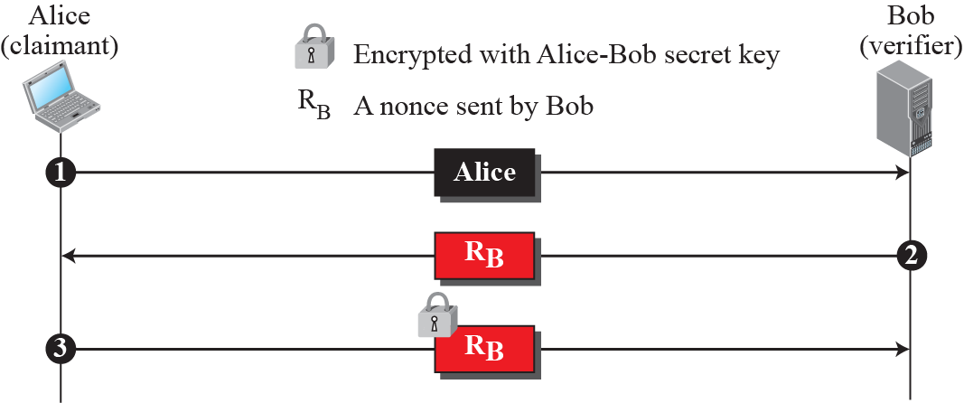
Figure 16.16 Unidirectional, symmetric-key authentication

Slide 54
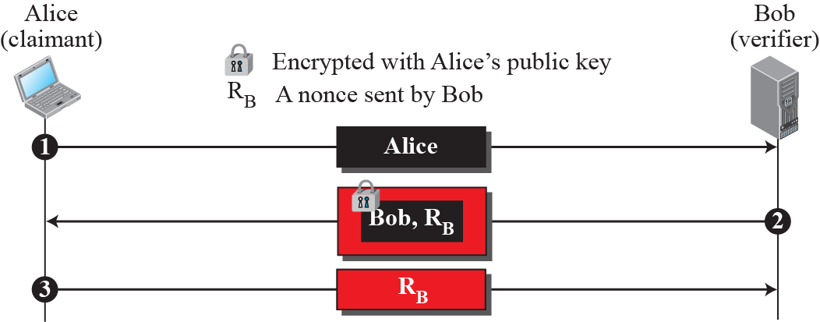
Figure 16.17 Unidirectional, asymmetric-key authentication

Slide 55
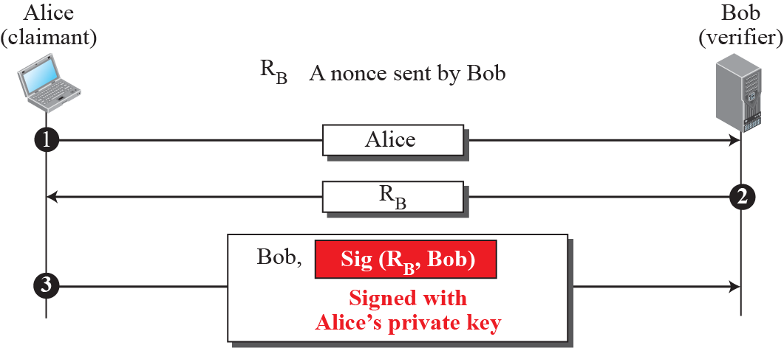
Figure 16.18 Digital signature, unidirectional authentication

Slide 56
16.3.5 Key management
We discussed symmetric-key and asymmetric-key cryptography in the previous sections. However, we have not yet discussed how secret keys in symmetric-key cryptography, and public keys in asymmetric-key cryptography, are distributed and maintained. This section touches on these two issues.
Symmetric-key distribution
Symmetric-key cryptography is more efficient than asymmetric-key cryptography for enciphering large messages. Symmetric-key cryptography, however, needs a shared secret key between two parties.

Slide 57
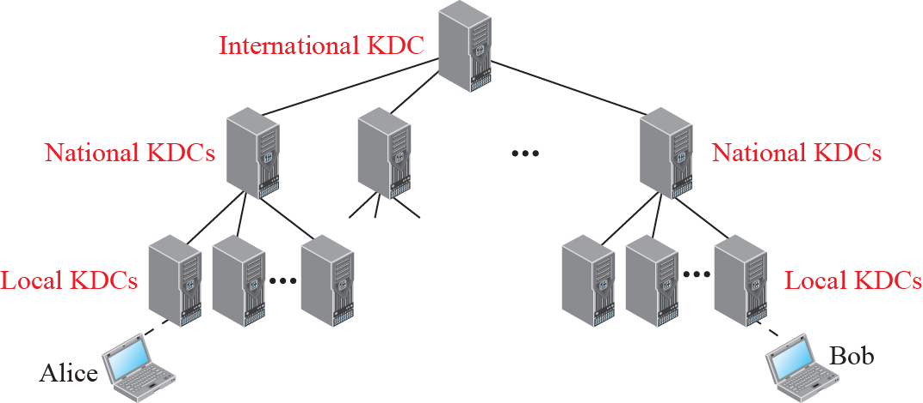
Figure 16.19 Multiple KDCs
A session symmetric key between two parties is used only once.

Slide 58
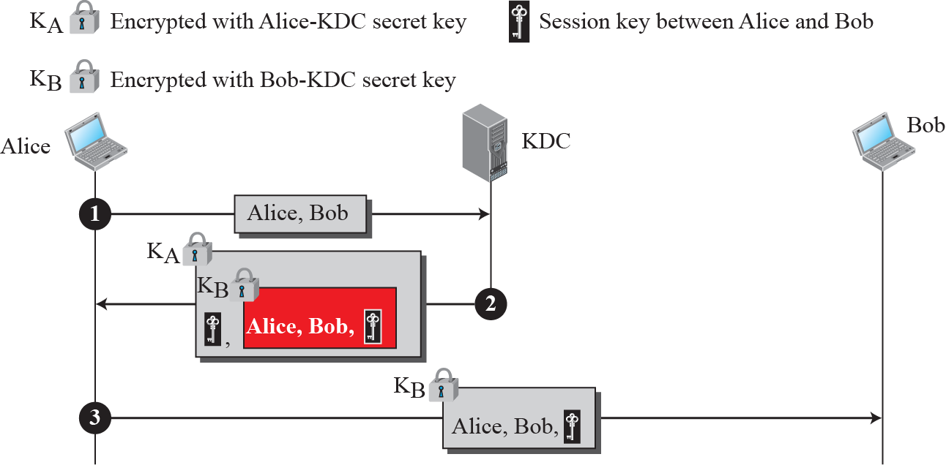
Figure 16.20 Creating a session key using KDC

Slide 59

Public-key distribution
In asymmetric-key cryptography, people do not need to know a symmetric shared key. If Alice wants to send a message to Bob, she only needs to know Bob’s public key, which is open to the public and available to everyone. If Bob needs to send a message to Alice, he
only needs to know Alice’s public key, which is also known to everyone. In public-key cryptography, everyone shields a private key and advertises a public key.
In public-key cryptography, everyone has access to everyone’s public key; public keys are available to the public.

Slide 60
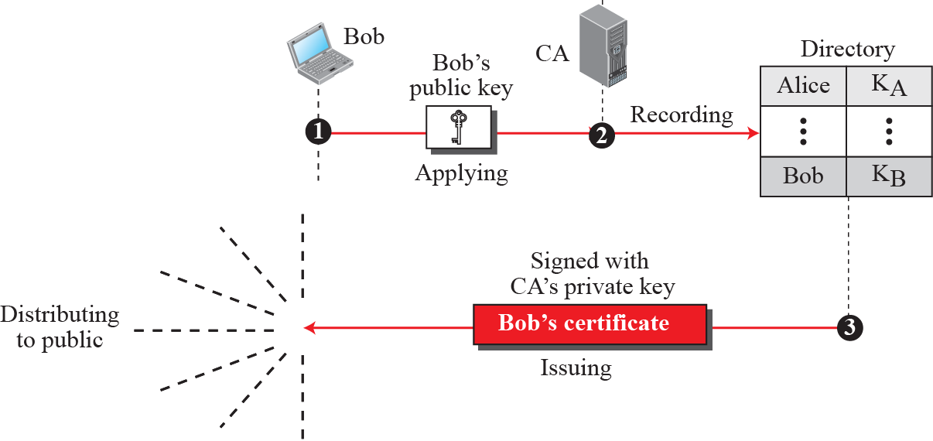
Figure 16.21 Certification authority

Slide 61
16-4 FIREWALS
All previous security measures cannot prevent Eve from sending a harmful message to a system. To control access to a system we need firewalls. A firewall is a device (usually a router or a computer) installed between the internal network of an organization and the
rest of the Internet. It is designed to forward some packets and filter (not forward) others. Figure 16.22 shows a firewall.

Slide 62
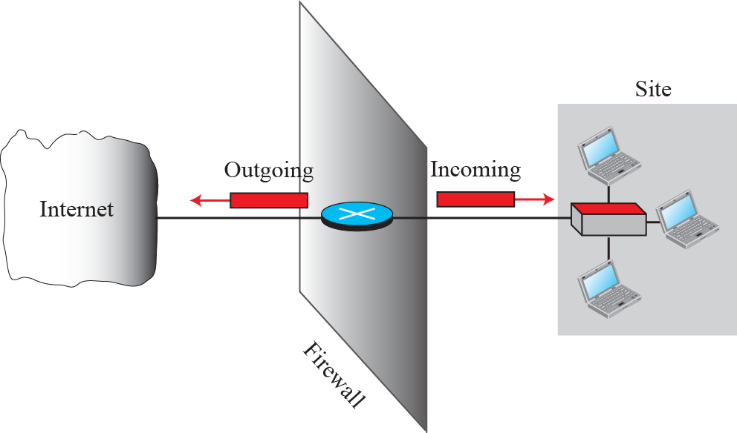
Figure 16.22 General idea of symmetric-key cipher

Slide 63
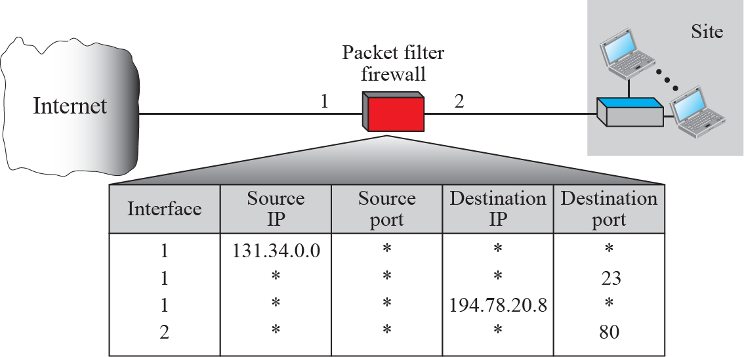
16.4.1 Packet filter firewall
A firewall can be used as a packet filter. It can forward or block packets based on the information in the network-layer and transport-layer headers: source and destination IP addresses, source and destination port addresses, and type of protocol (TCP or UDP). A packet-filter firewall is a router that uses a filtering table to decide which packets must be discarded (Figure 16.23).
Figure 16.23 Packet-filter firewall

Slide 64
16.4.1 Proxy firewall
The packet-filter firewall is based on the information available in the network-layer and transport-layer headers (IP and TCP/UDP). However, sometimes we need to filter a message based on the information available in the message itself (at the application layer).
A proxy firewall stands between the customer computer and the corporation computer. When the user client process sends a message, the application gateway runs a server process to receive the request. The server opens the packet at the application level and finds out if the request is legitimate. If it is, the server acts as a client process and sends the message to the real server in the corporation. If it is not, the message is dropped and an error message is sent to the external user. Figure 16.24 shows a proxy firewall.

Slide 65
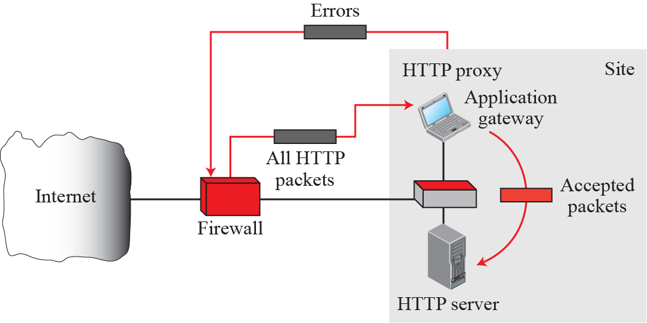
Figure 16.24 Proxy firewall

